Slide 1

Mazen
Saad
Computer teacher

Slide 2
ICT
Grade 4

Slide 3

Enter the notebook and write the following:

Slide 4
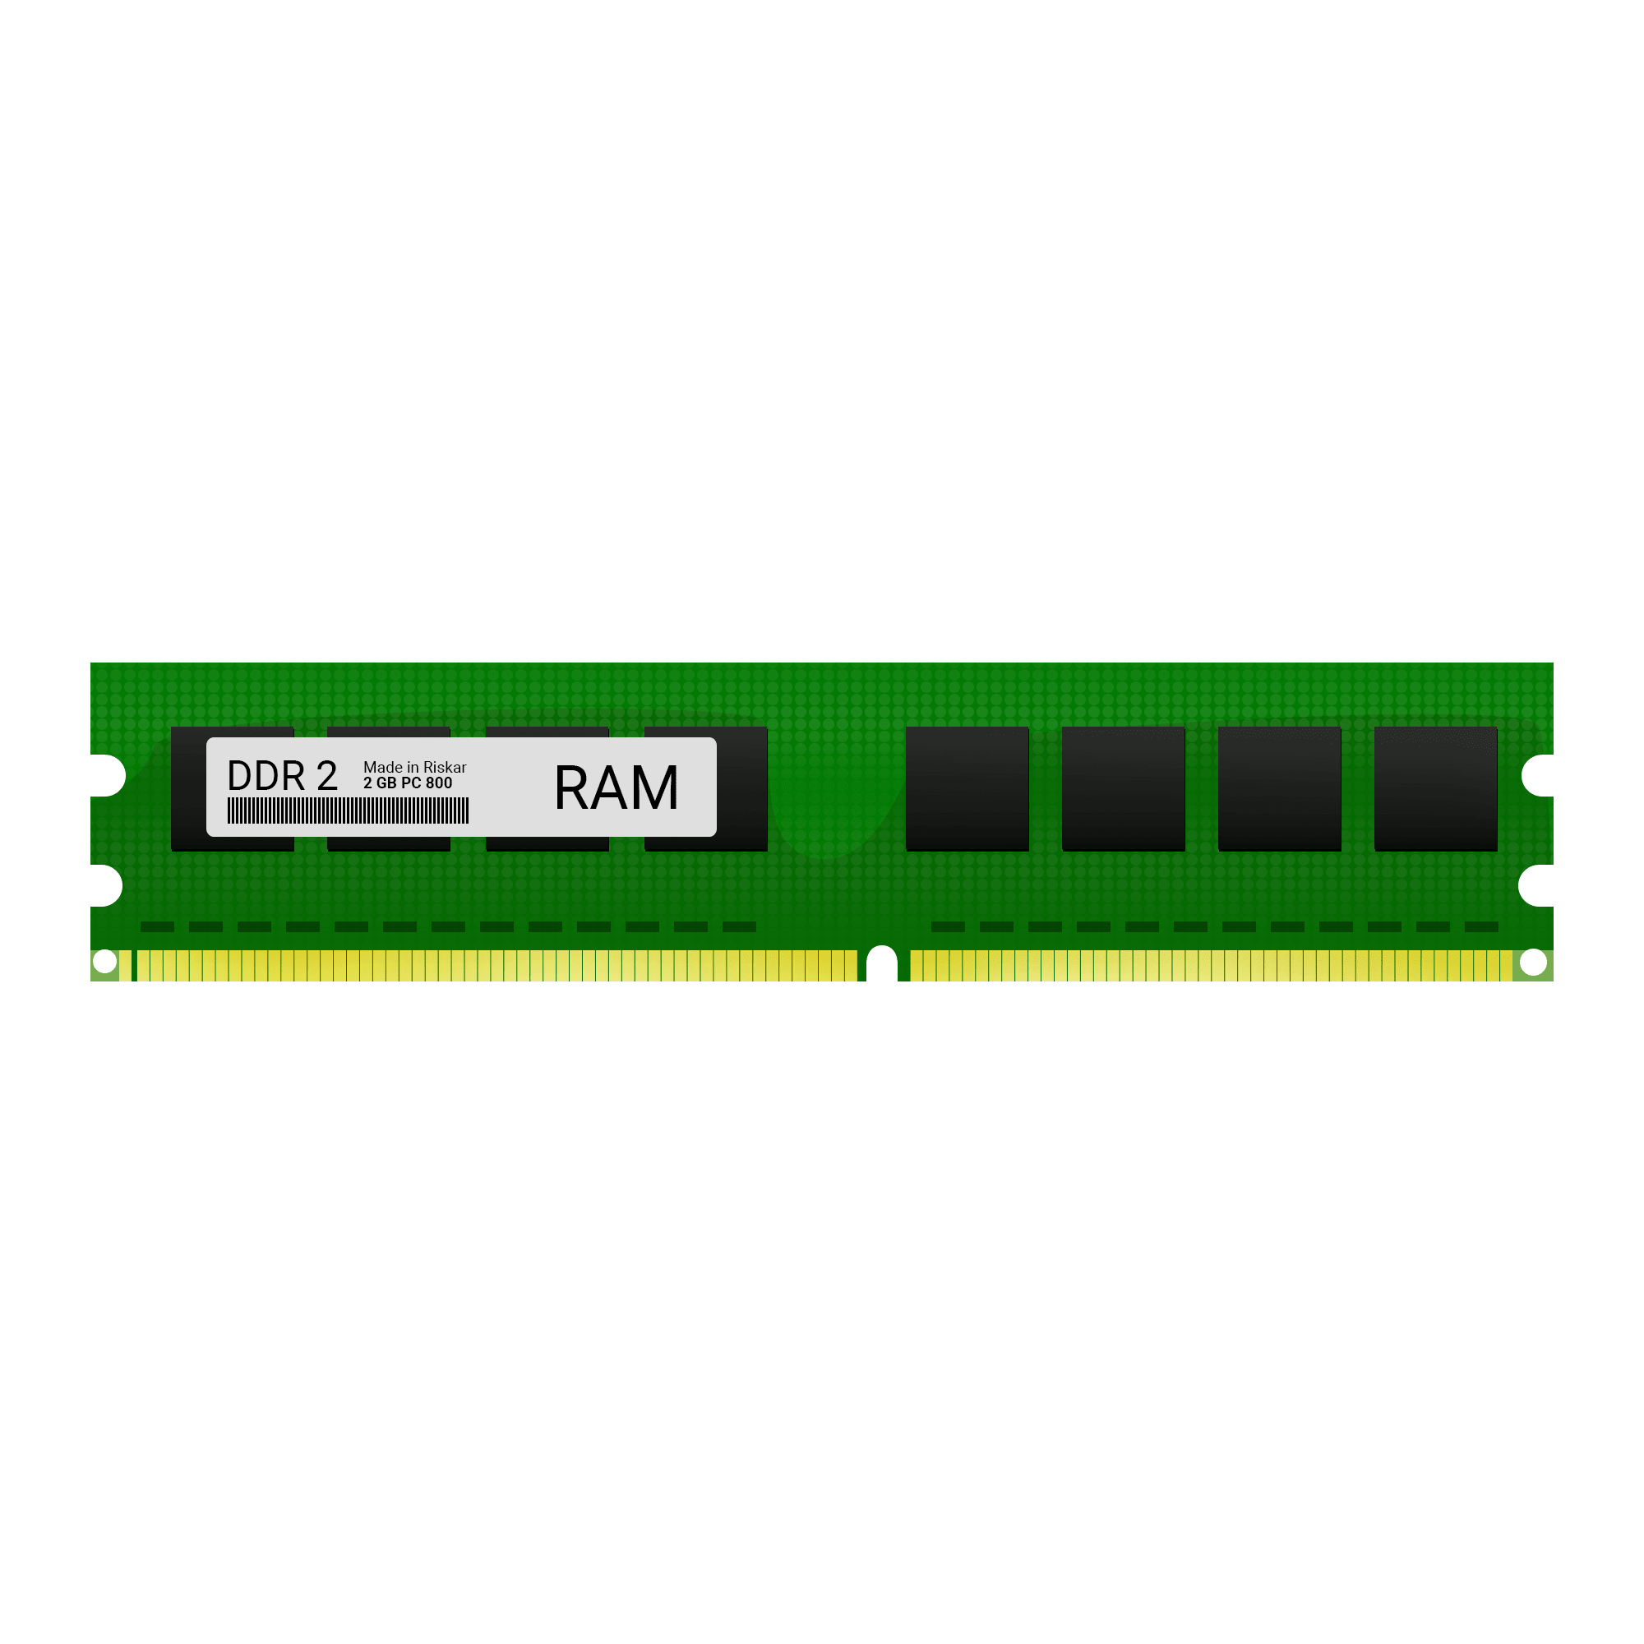
Lesson title
Computer Memory
The Date
2025 / 9 /

Slide 5
1- the quantity of memory occupied in a computer is measured in bytes 2- 1 kilo Byte (kb)=1024 bytes. 3- in a computer, data is stored in a digital storage device or memory device 4- the computer has a management system called the memory management Unit (MMU).

Slide 6
5- RAM (random access memory) 6- GPU (Graphics Processing Unit) 8- When a new program stats on the computer, its information is stored in the RAM. 9- Rom is the permanent memory that stores read only data.

Slide 7
10- the speed to read and write data is faster than HDD. 11- GPU helps us play high definition Video games and make computer animations and drawings.

Slide 8
Start

Slide 9

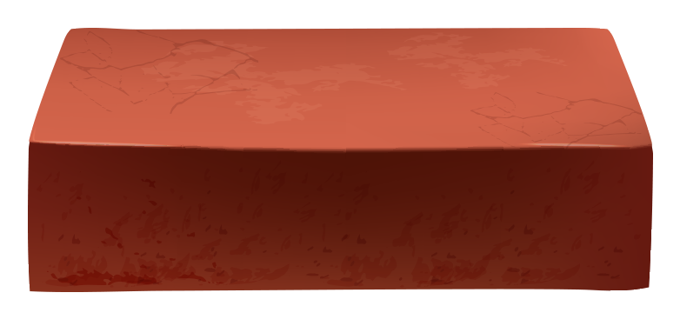
Do you know what Bytes are?

Slide 10





1- the quantity of memory occupied in a computer is measured in Bytes.

Slide 11
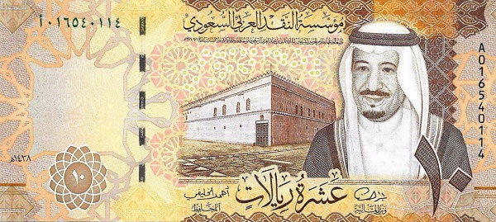
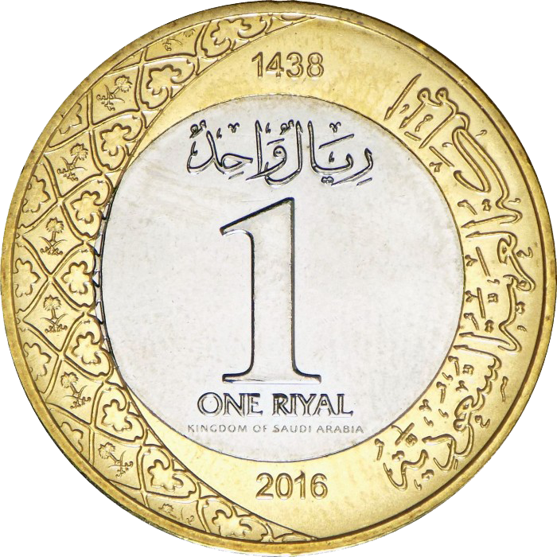
2- 1 kilo Byte (kb) =1024 bytes.

Slide 12

Do you know what digital storage device are?

Slide 13
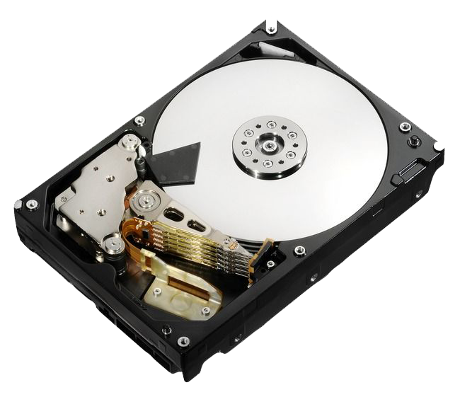
3- in a computer, data is stored in a digital storage device or memory device

Slide 14

We follow the explanation
Yes Or No

Slide 15

Do you know what RAM are?

Slide 16
4- the computer has a management system called the memory management Unit (MMU).

Slide 17

5- RAM (Random access memory)

Slide 18

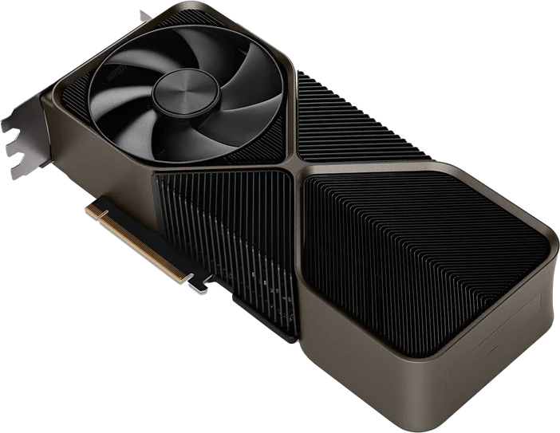
Do you know what GPU are?

Slide 19
6- GPU (Graphics Processing Unit).

Slide 20
7- When a new program stats on the computer, its information is stored in the RAM.

Slide 21
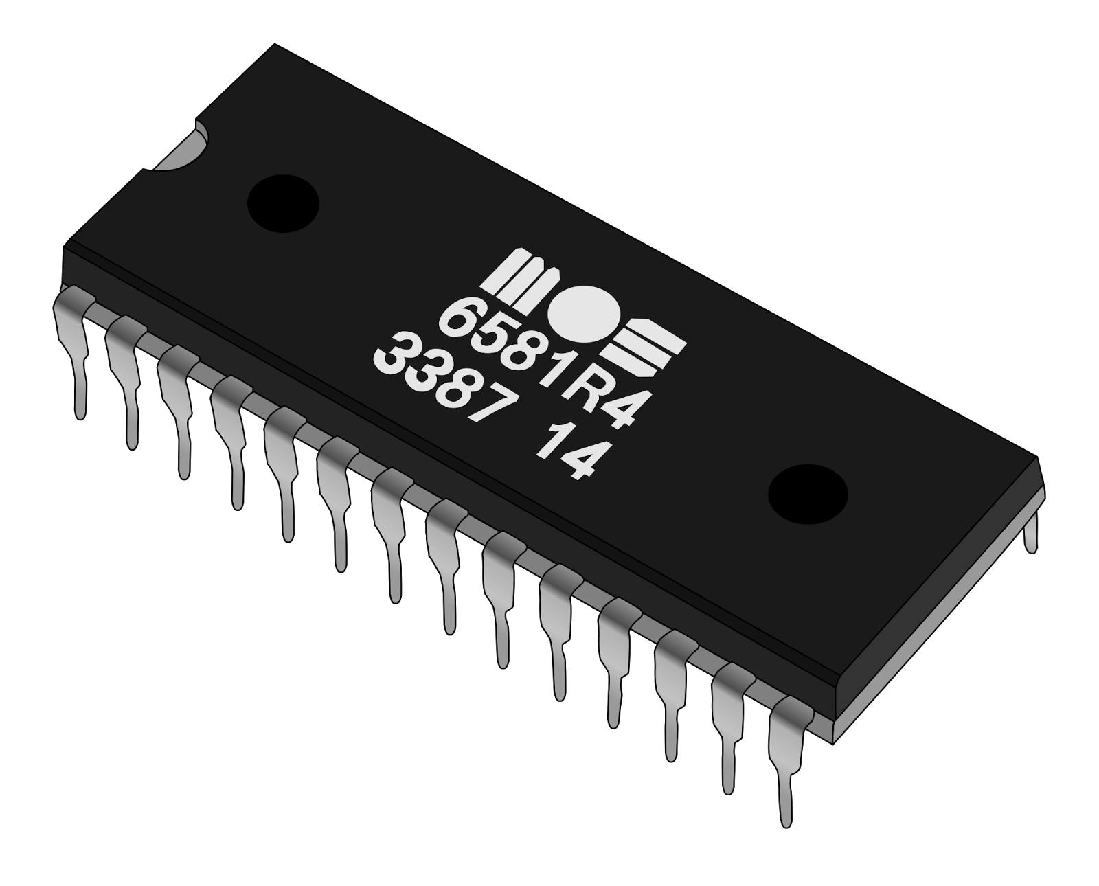
9- Rom is the permanent memory that stores read only data.

Slide 22

10- (SSD) the speed to read and write data is faster than HDD.

Slide 23
11- GPU helps us play high definition Video games and make computer animations and drawings.

Slide 24

Exercise

Slide 25
Page Number 04

Slide 26
The Unit of Memory is …………..

Slide 27
The Unit of Memory is Bytes.

Slide 28
2- If 1KB is 1024 Bytes, then 3 KB is …….. Bytes.

Slide 29
2- If 1KB is 1024 Bytes, then 3 KB is 3072 Bytes.

Slide 30
Page Number 07

Slide 31
3- Data in a computer is stored in ______________

Slide 32
3- Data in a computer is stored in Digital storage devices

Slide 33
4- The unit that manages storage devices in a computer is called ___________

Slide 34
4- The unit that manages storage devices in a computer is called Memory management unit (MMU)

Slide 35

5- The full form of RAM is ______________

Slide 36
5- The full form of RAM is Random Access Memory

Slide 37

6- The full form of GPU is ______________

Slide 38
6- The full form of GPU is Graphics Processing Unit

Slide 39

Homework

Slide 40
Page Number 12

Slide 41

Thank you for everything

